Slide 1
MDSE Use Cases
Chapter #3

Slide 2
MDSE goes far beyond code-generation

Slide 3
MDSE has many applications
MDD is just the tip of the iceberg
  And MDA a specific “realization” of MDD when using OMG standards

Slide 4
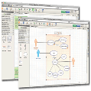








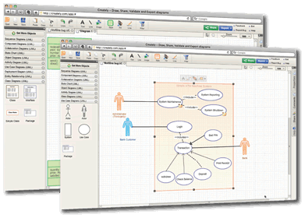
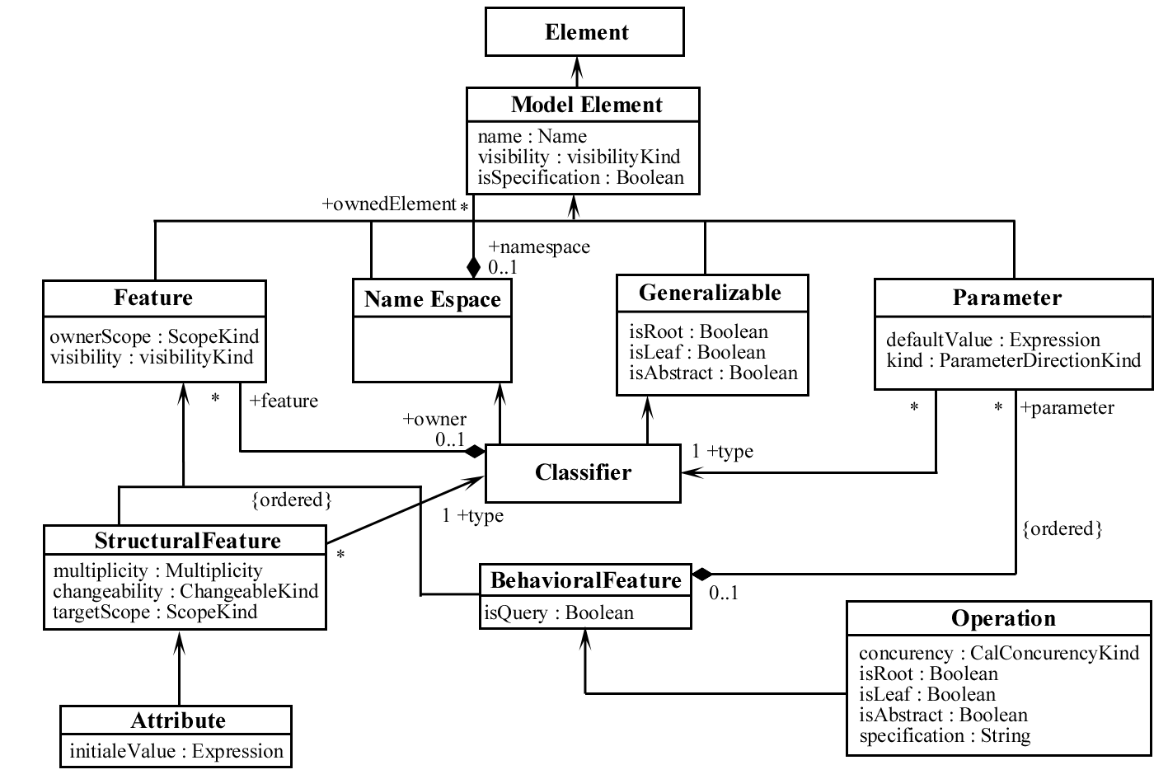



Three killer MDSE applications
Code
Generation
Software
Modernization
Systems interoperability

Slide 5
Use Case1 – Model driven deveLopment

Slide 6
MDD contribution: Communication
Models capture and organize the understanding of the system within a group of people
Models as lingua franca between actors from business and IT divisions

Slide 7



MDD contribution: Productivity
MDD (semi)automates software development
In MDD, software is derived through a series of model-to-model transformations (possibly) ending with a model-to-text transformations that produces the final code
Original model
1st refinement
n^{th} refinement
...
Model-to-model Transformation
Model-to-text Transformation

Slide 8
Executable models
An executable model is a model complete enough to be executable
From a theoretical point of view, a model is executable when its operational semantics are fully specified
In practice, the executability of a model may depend on the adopted execution engine
  models which are not entirely specified but that can be executed by some advanced tools that are able to fill the gaps
  Completely formalized models that cannot be executed because an appropriate execution engine is missing.

Slide 9
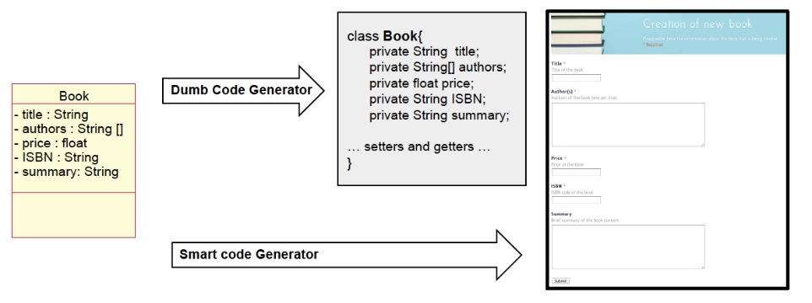
Smart vs dumb execution engines
CRUD operation typically account for 80% of the overall software functionality
Huge spared effort through simple generation rules

Slide 10
Executable models
Most popular: Executable UML models
Executable UML development method (xUML) initially proposed by Steve Mellor
Based on an action language (kind of imperative pseudocode)
Current standards
  Foundational Subset for Executable UML Models (fUML)
  Action language is the Action Language for fUML (Alf)
    basically, a textual notation for UML behaviors that can be attached to a UML model

Slide 11
Executable models: 2 main approaches
Code generation: generating running code from a higher level model in order to create a working application
  by means of a rule-based template engine
  common IDE tools can be used to render the source code produced
Model interpretation: interpreting the models and making them run
Non-empty intersection between the two options

Slide 12
Code Generation
Goal: generating running code from higher level models
  Like compilers producing executable binary files from source code
  Also known as model compilers
Once the source code is generated state-of-the-art IDEs can be used to manipulate the code

Slide 13
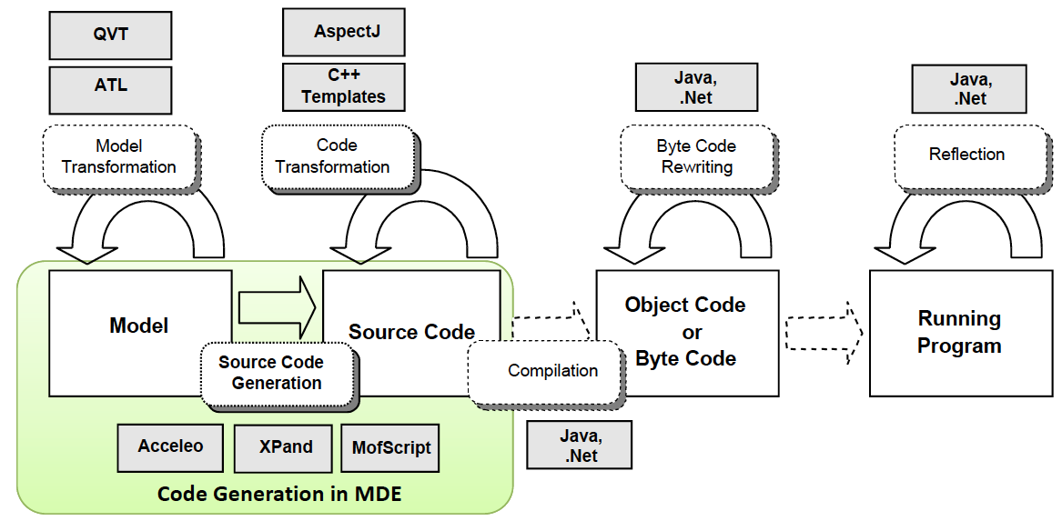
Code Generation: Scope

Slide 14
Code Generation: Benefits
Separation of modeling and execution
Multi-platform generation
Generators simpler than interpreters
Reuse of existing artefacts
Adaptation to enterprise policies
Better performances

Slide 15
Code Generation: Partial Generation
Input models are not complete & code generator is not smart enough to derive or guess the missing information
Programmers will need to complete the code manually
Caution! Breaking the generation cycle is dangerous
Solutions:
Defining protected areas in the code, which are the ones to be manually edited by the developer
Using round-trip engineering tools (not many available)
Better to do complete generation of parts of the system instead of partial generation of the full system

Slide 16
Code Generation: Turing test
A human judge examines the code generated by one programmer and one code-generation tool for the same formal specification. If the judge cannot reliably tell the tool from the human, the tool is said to have passed the test

Slide 17
Model interpretation
A generic engine parses and executes the model on-the-fly using an interpretation approach
Benefits
  Faster changes & Transparent (re)deployment
  Better portability (if the vendor supports several platforms)
  The model is the code. Easier model debugging
  No deployment
  Updates of the model at runtime
  Higher level abstraction of the system (implemented by the interpreter)
  Updates in the interpreter may result in automatic improvements of your software
Danger of becoming dependent of the application vendor. Limited influence in the –ities of the SW

Slide 18
Generation and interpretation
Can be used together in the same process
  Interpretation at early prototyping / debugging time
  Generation for production and deployment
Hybrid solutions are possible:
  Model interpretation based on internal code generation implementation
  Code generation that relies on predefined, configurable components / framework at runtime. The generated code is e.g., XML descriptor / configurations of the components

Slide 19
USE CASE2 – Systems interoperability

Slide 20
Interoperability
Ability of two or more systems to exchange information (IEEE)
Needed for collaborative work (e.g. using different tools), tool and language evolution, system integration…
Interoperability must be done at the syntactic and semantic levels

Slide 21
Model-Driven Interoperability
MDSE techniques to bridge the interoperability gap
The metamodels (i.e. “schemas”) of the two systems are made explicit and aligned
Transformations follow the alignment to move information
  Injectors (text-to-model) represent system A data as a model (syntactic transformation)
  M2M transformation adapts the data to system B metamodel (semantic transformation)
  Extractors (model-to-text) generate the final System B output data (syntactic transformation).

Slide 22
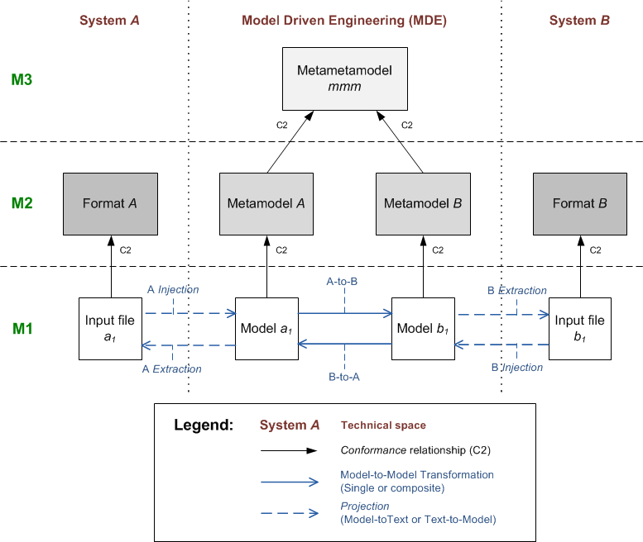
MDI: Global schema

Slide 23
USE CASE3 – Model driven reverse engineering

Slide 24
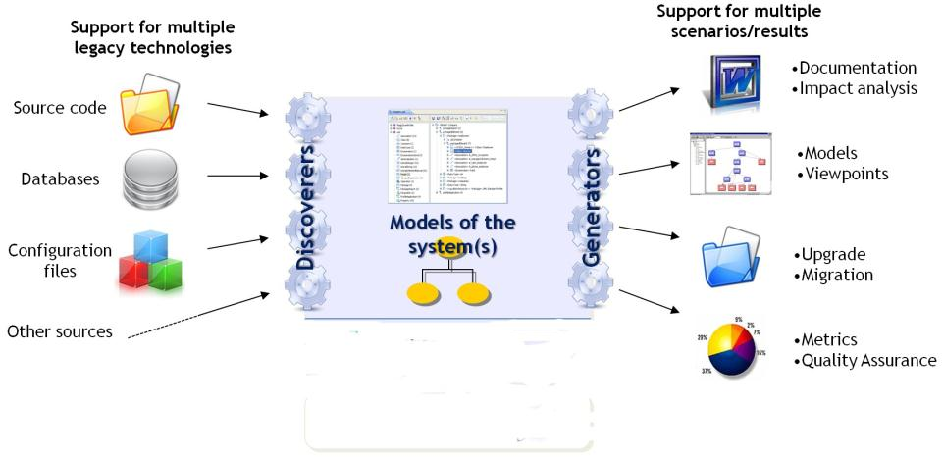
Need for reverse engineering

Slide 25


Model-driven reverse engineering
Why? Models provide a homogeneous and interrelated representation of all legacy components.
  No information loss: initial models have a 1:1 correspondence with the code
Discover
Understand
Regenerate
Legacy artifacts :
- source code
- configuration files
- tests
- databases
- etc.
Models
Viewpoints
New
Software Artifacts

Slide 26
Model-Driven Interoperability: Example
Model discovery
Model understanding
Model generation
COBOL
metamodel
UML
metamodel
Java
metamodel
COBOL system
T2M
COBOL
model
M2M
UML
models
M2M
Java
model
M2T
Java system
M2M (refactorings)

Slide 27
Model-Driven Software Engineering in Practice
Marco Brambilla,
Jordi Cabot,
Manuel Wimmer.
Morgan & Claypool, USA, 2012.
www.mdse-book.com
www.morganclaypool.com
or buy it at: www.amazon.com

