Slide 1
INTRODUCTION
Chapter #1

Slide 2
Introduction
Contents
Human cognitive processes
Models
Structure of the book

Slide 3
Abstraction and human mind
The human mind continuously re-works reality by applying cognitive processes
Abstraction: capability of finding the commonality in many different observations:
  generalize specific features of real objects (generalization)
  classify the objects into coherent clusters (classification)
  aggregate objects into more complex ones (aggregation)
Model: a simplified or partial representation of reality, defined in order to accomplish a task or to reach an agreement

Slide 4
Models
What is a model?
Model
System
represents
Mapping Feature | A model is based on an original (=system)
Reduction Feature | A model only reflects a (relevant) selection of the original‘s properties
Pragmatic Feature | A model needs to be usable in place of an original with respect to some purpose
Purposes:
descriptive purposes
prescriptive purposes

Slide 5
Motivation
What is Model Engineering?
Model as the central artifact of software development
Related terms
  Model Driven Engineering (MDE),
  Model Driven [Software] Development (MDD/MDSD),
  Model Driven Architecture (MDA)
  Model Integrated Computing (MIC)
Static analysis
Documentation
Rapid prototyping
Model
Refactoring/
Transformation
Code generation
Automated testing
[Illustration by Bernhard Rumpe]

Slide 6
Motivation
Why Model Engineering?
Increasing complexity of software
  Increasing basic requirements, e.g., adaptable GUIs, security, network capabilities, …
  Complex infrastructures, e.g., operating system APIs, language libraries, application frameworks
Software for specific devices
  Web browser, mobile phone, navigation system, video player, etc.
Technological progress …
  Integration of different technologies and legacy systems, migration to new technologies
… leads to problems with software development
  Software finished too late
  Wrong functionality realized
  Software is poorly documented/commented
  and can not be further developed, e.g., when the technical environment changes, business model/ requirements change, etc.

Slide 7
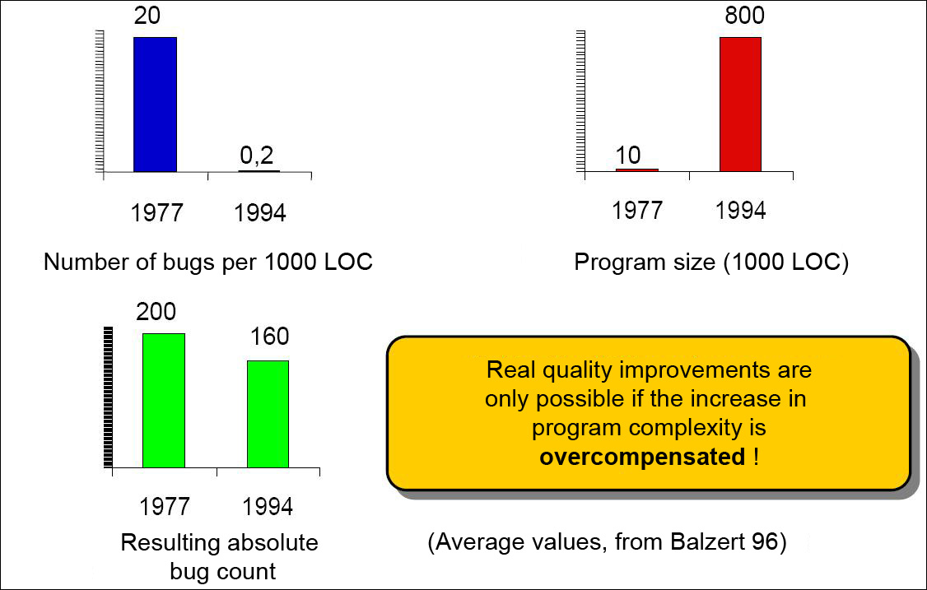
Motivation
[Balzert, H.: Lehrbuch der Softwaretechnik:
Software-Entwicklung, Spektrum, Akad. Verlag, 1996]
Why Model Engineering?
Quality problems in software development
[Slide by Bernhard Rumpe]

Slide 8
Motivation
Why Model Engineering?
Traditional usage of models in software development
  Communication with customers and users (requirement specification, prototypes)
  Support for software design, capturing of the intention
  Task specification for programming
  Code visualization, for example in TogetherJ
What is the difference to Model Engineering?

Slide 9
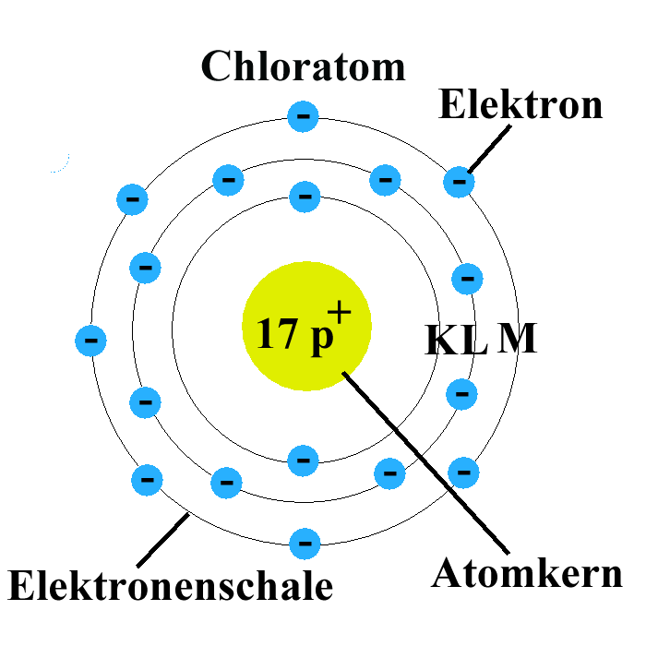
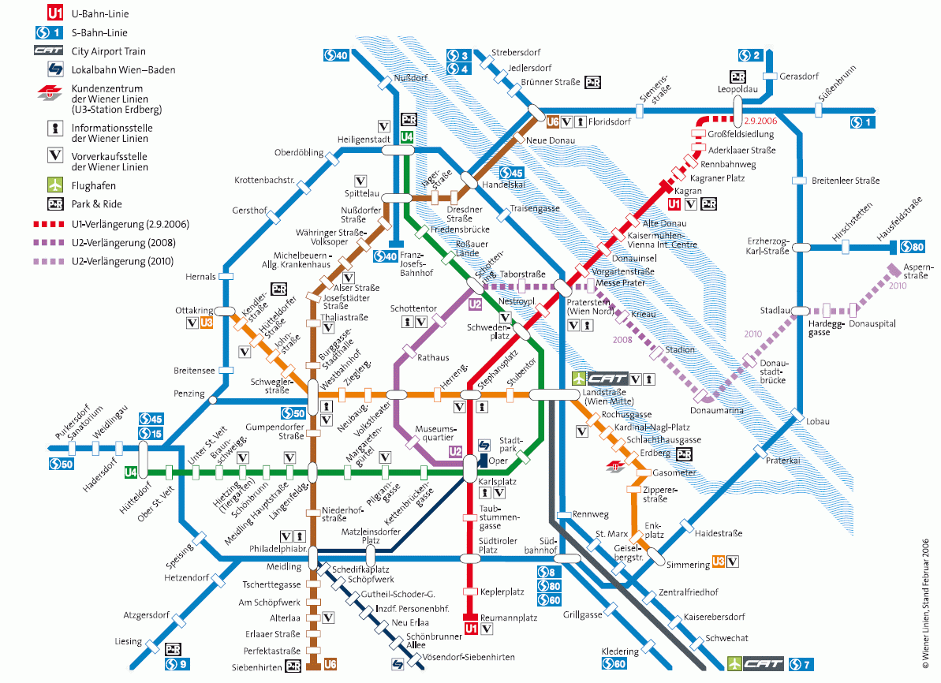
Motivation
Usage of models
Do not apply models as long as you have not checked the underlying simplifications and evaluated its practicability.
Never mistake the model for the reality.
  Attention: abstraction, abbreviation, approximation, visualization, …
chlorine atom
electron
electron shell
atom nucleus

Slide 10
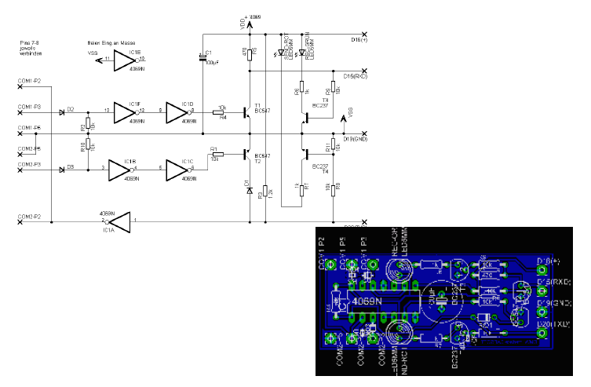
Motivation
Constructive models (Example: Electrical Engineering)
[Slide by Bernhard Rumpe]

Slide 11
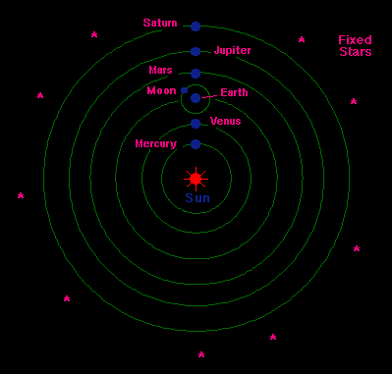
Motivation
Declarative models (Example: Astronomy)
Heliocentric model by Kopernikus

Slide 12
Motivation
Application area of modeling
t
Models as drafts
  Communication of ideas and alternatives
  Objective: modeling per se
Models as guidelines
  Design decisions are documented
  Objective: instructions for implementation
Models as programs
  Applications are generated automatically
  Objective: models are source code and vice versa

Slide 13
Motivation
Increasing abstraction in software development
The used artifacts of software development
slowly converge to the concepts of
the application area
Business objects
(course, account, customer)
Components (provided/required interface)
Libraries (GUI, lists)
Procedural constructs
(while, case, if)
Assembler and mnemonic
abbreviations (MV, ADD, GET)
Assembler (001001)
[Illustration by Volker Gruhn]

Slide 14
Structure of the book
PART 1: MDSE Foundations
1 Introduction
1.1 Purpose and Use of Models
1.2 Modeling for Software Development
1.3 How to Read this Book
2 MDSE Principles
2.1 MDSE Basics
2.2 Lost in Acronyms: The MD* Jungle
2.3 Overview of the MDSE Methodology
2.3.1 Overall Vision
2.3.2 Target of MDSE: Domains, Platforms,Technical Spaces, and Scenarios
2.3.3 Modeling Languages
2.3.4 Metamodeling
2.3.5 Transformations
2.3.6 Model Classification
2.4 MDSE Adoption in Industry
2.5 Tool Support
2.5.1 Drawing Tools vs Modeling Tools
2.5.2 Model-Based vs Programming-Based MDSE Tools
2.5.3 Eclipse and EMF
2.6 Criticisms of MDSE

Slide 15
Structure of the book
PART 1: MDSE Foundations (continued)
3 MDSE Use Cases
3.1 Automating Software Development
3.1.1 Code Generation
3.1.2 Model Interpretation
3.1.3 Combining Code Generation and Model Interpretation
3.2 System Interoperability
3.3 Reverse Engineering
4 Model-Driven Architecture (MDA)
4.1 MDA Definitions and Assumptions
4.2 The Modeling Levels: CIM, PIM, PSM
4.3 Mappings
4.4 General Purpose and Domain-Specific Languages in MDA
4.5 Architecture-Driven Modernization
5 Integration of MDSE in your Development Process
5.1 Introducing MDSE in your Software Development Process
5.1.1 Pains and Gains of Software Modeling
5.1.2 Socio-Technical Congruence of the Development Process
5.2 Traditional Development Processes and MDSE
5.3 Agile and MDSE
5.4 Domain-Driven Design and MDSE
5.5 Test-Driven Development and MDSE
5.5.1 Model-Driven Testing
5.5.2 Test-Driven Modeling

Slide 16
Structure of the book
PART 1: MDSE Foundations (continued)
6 Modeling Languages at a Glance
6.1 Anatomy of Modeling Languages
6.2 General Purpose vs Domain-Specific Modeling Languages
6.3 General-Purpose Modeling: The Case of UML
6.4 UML Extensibility: The MiddleWay Between GPL and DSL
6.5 Overview on DSLs (Domain Specific Languages)
6.5.1 Principles of DSLs
6.5.2 Some Examples of DSLs
6.6 Defining Modeling Constraints (OCL)
PART 2: MDSE Technologies
7 Developing Your Own Modeling Language
7.1 Metamodel-Centric Language Design
7.1.1 Abstract Syntax
7.1.2 Concrete Syntax
7.1.3 Language Ingredients at a Glance
7.2 Example DSML: sWML
7.3 Abstract Syntax Development
7.3.1 Metamodel Development Process
7.3.2 Metamodeling in Eclipse
7.4 Concrete Syntax Development
7.4.1 Graphical Concrete Syntax (GCS)
7.4.2 Textual Concrete Syntax (TCS)

Slide 17
Structure of the book
PART 2: MDSE Technologies (continued)
8 Model-to-Model Transformations
8.1 Model Transformations and their Classification
8.2 Exogenous, Out-Place Transformations
8.3 Endogenous, In-Place Transformations
8.4 Mastering Model Transformations
8.4.1 Divide and Conquer: Model Transformation Chains
8.4.2 HOT: Everything is a Model, Even Transformations!
8.4.3 Beyond Batch: Incremental and Lazy Transformations
8.4.4 Bi-Directional Model Transformations
9 Model-to-Text Transformations
9.1 Basics of Model-Driven Code Generation
9.2 Code Generation Through Programming Languages
9.3 Code Generation Through M2T Transformation Languages
9.3.1 Benefits of M2T Transformation Languages
9.3.2 Template-Based Transformation Languages: an Overview
9.3.3 Acceleo: An Implementation of the M2T Transformation Standard
9.4 Mastering Code Generation
9.5 Excursus: Code Generation Through M2M Transformations and TCS

Slide 18
Structure of the book
PART 2: MDSE Technologies (continued)
10 Managing Models
10.1 Model Interchange
10.2 Model Persistence
10.3 Model Comparison
10.4 Model Versioning
10.5 Model Co-Evolution
10.6 Global Model Management
10.7 Model Quality
10.7.1 Verifying Models
10.7.2 Testing and Validating Models
10.8 Collaborative Modeling
11 Summary
Bibliography
Authors’ Biographies

Slide 19
Model-Driven Software Engineering in Practice
Marco Brambilla,
Jordi Cabot,
Manuel Wimmer.
Morgan & Claypool, USA, 2012.
www.mdse-book.com
www.morganclaypool.com
or buy it at: www.amazon.com

